Slide 1
DRIVERS DROWSINESS DETECTION
PRESENTED BY:
M.ABHIGNA REDDY(16681A0572)
UNDER THE GUIDANCE OF : M.BALA CHETHAN CHOWDARY(16681A0571)
S. VIJAYALAXMI. M.PRAVEEN REDDY(16681A0579)

Slide 2
CONTENTS
OBJECTIVE
INTRODUCTION
MEASURES TO DETECT
PROPOSED SYSTEM
ALGORITHM STAGES
REQUIREMENTS
DETECTION OF OBJECT USING OpenCV
IMPLEMENTATION OF HARDWARE
INPUT IMAGES AND OUTPUT
CONCLUSION
FUTURE ENHANCEMENT

Slide 3
OBJECTIVE
Nowadays the driver safety in the car is one of the most wanted system to avoid accidents.. Our objective of the project is to ensure the safety system. For enhancing the safety, we are detecting the eye blinks of the driver and estimating the driver status and control the car accordingly.

Slide 4
INTRODUCTION
Driver drowsiness detection is a car safety technology which helps prevent accidents caused by the driver getting drowsy. In this we present a module for Advanced Driver Assistance System (ADAS) to reduce the number of accidents due to drivers fatigue and hence increase the transportation safety.
We try locate, track, and analyze both the drivers face and eyes to measure PERCLOS(persistent eye closure).

Slide 5
MEASURES TO DETECT
Vehicle based measures
Physiological measures
Behavioural measures

Slide 6
Vehicle bases measures:
Vehicle-based measures survey path position, which monitors the vehicle's position as it identifies with path markings, to determine driver weakness, and accumulate steering wheel movement information to characterize the fatigue from low level to high level.
This is done by:
1. Sudden deviation of vehicle from lane position.
2.Sudden movement of steering wheels.
3.Pressure on acceleration paddles.

Slide 7
Physiological measures:-
Physiological measures are the objective measures of the physical changes that occur in our body because of fatigue.
Monitoring Heart Rate
Monitoring Brain Waves
Monitoring muscle fatigue
Monitoring eye movement

Slide 8
Behavioural measures:-
Certain behavioral changes take place during drowsing like
1.Yawning
2.Amount of eye closure
3.Eye blinking
4.Head position

Slide 9
PROPOSED SYSTEM
This project involves controlling vehicle accident & saving driver's life by alerting him, the car is fitted with a camera inside at the driver's side so that the driver's face is clearly seen.
This camera is further connected to the ARM microcontroller device i.e., Raspberry pi which is remotely connected to the webserver or the android app in the real time
when ever the driver blinks his eye it counts the number of blinks. If the blinking period is more than second, we consider the driver as drowsy
Immediate action will be taken & buzzer will immediately blown up and alerts the driver to wake up.

Slide 10
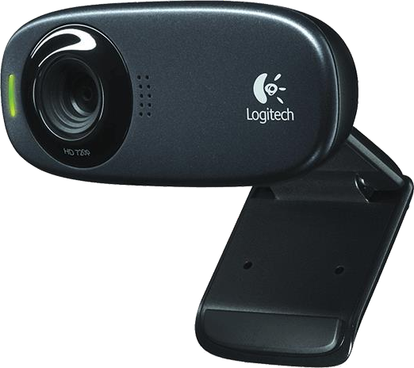
ALGORITHM STAGES
Image capture
Dividing into frames
Face detection
Eye detection

Slide 11
REQUIREMENTS
HARDWARE REQUIREMENTS:
System : Pentium Dual Core.
Hard Disk : 120 GB.
Monitor : 15’’ LED
Input Devices : Keyboard, Mouse
Ram : 1 GB
SOFTWARE REQUIREMENTS:
Operating system : Windows 7.
Coding Language : Python
Tool : PyCharm

Slide 12
DETECTION OF OBJECT USING OPENCV
Object detection
Face detection
Eye detection

Slide 13
IMPLEMENTATION OF HARDWARE
About raspberry pi
Viola-Jones algorithm
1.Haar features
2.Internal image
3.Ada boost
4.Cascade classifiers

Slide 14
About Raspberry-pi:
It is a low cost, credit-card sized computer which is used for implementing small projects. A monitor or TV has to be connected with it externally to visualize its operating system and operate it. We can use a key board and a mouse to provide input to it. An external memory has to be used to load its operating system. We can program it with several languages like C++, Python etc.

Slide 15
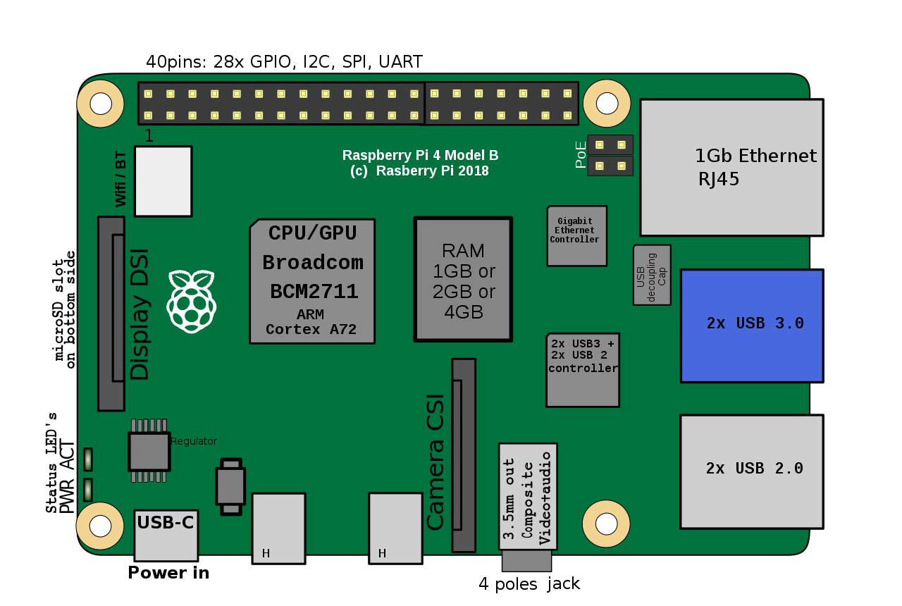
components of raspberry-pi:
Its components includes the following:
(1)700 MHz processor.
(2)512 MB RAM.
(3)USB ports for external devices.
(4)Micro SD card slots.
(5)Ethernet port.
(6)HDMI port.
(7)40 GPIO pins.
(8)Camera interface.
(9)Display interface.

Slide 16
Viola-Jones Algorithm:
Viola-Jones method can be used for several objects but most specifically here it is used for face and eye detection in real time.
Viola-Jones algorithm has four stages:
1.Haar Feature Selection
2.Creating an Integral Image
3.Adaboost Training
4.Cascading Classifiers

Slide 17
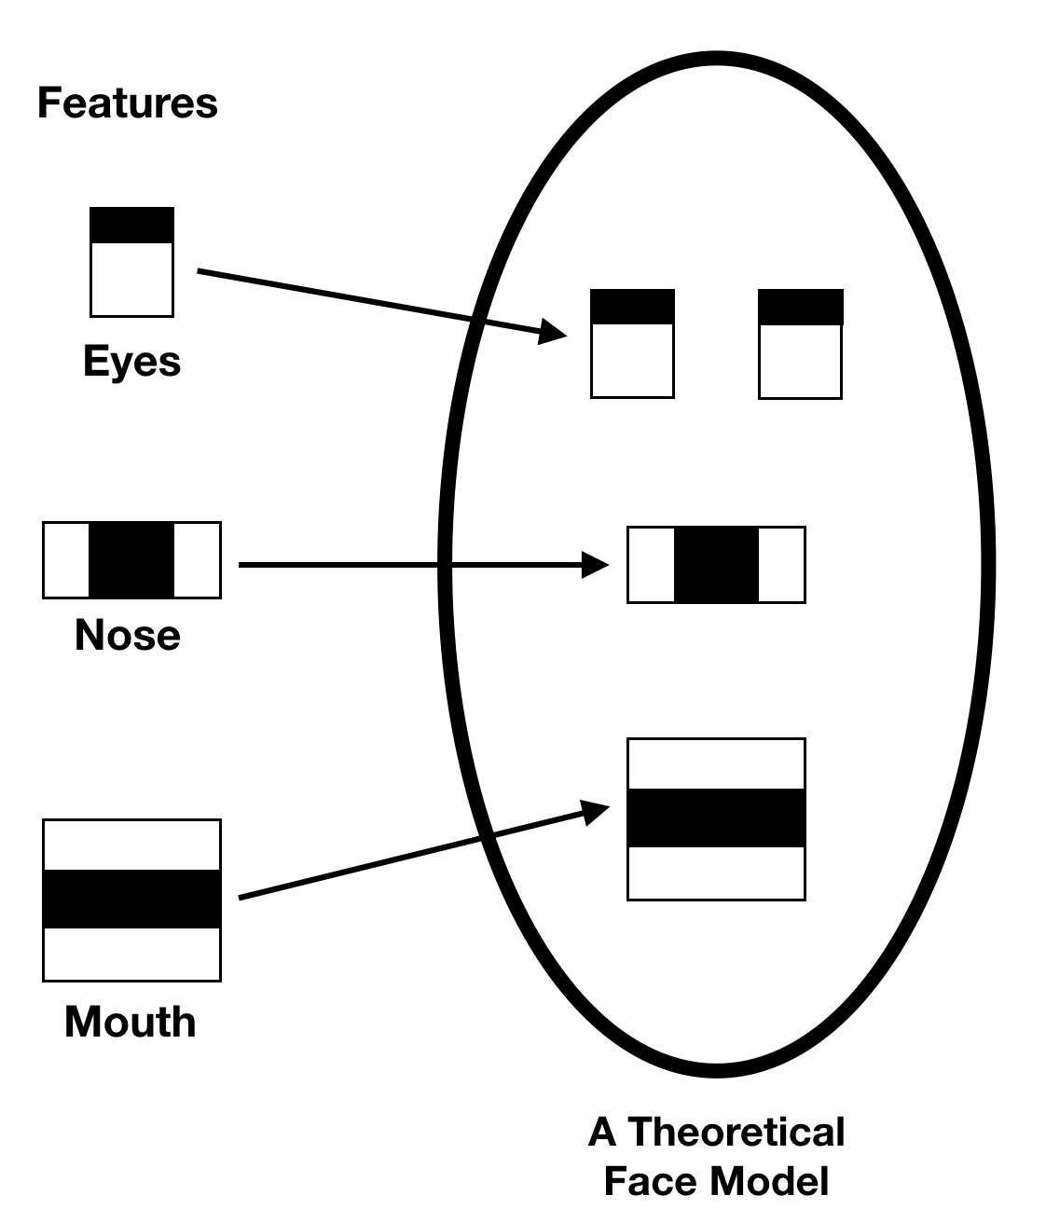
Haar feature selection:
Haar-like features are digital image features used in object detection. Or we can say that these are rectangle shaped dark and light areas having similar kind of features like our face. So basically we move those features throughout our face to find the output of each feature.

Slide 18
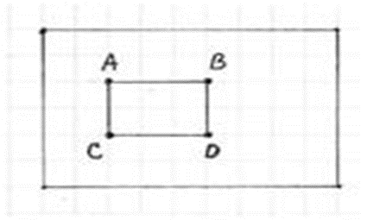
Internal Image:
Basically Internal image is a matrix same as size of the window. The integral image at location (x, y) is the sum of the pixels above and to the left of (x, y).
The integral image allows integrals for the Haar extractors to be calculated by adding only four numbers. For example, the image integral of area ABCD (Fig.1) is calculated as II( y_{A}, x_{A} ) + II( y_{B}, x_{B} ) + II( y_{C}, x_{C} ) + II( y_{D}, x_{D} ).

Slide 19
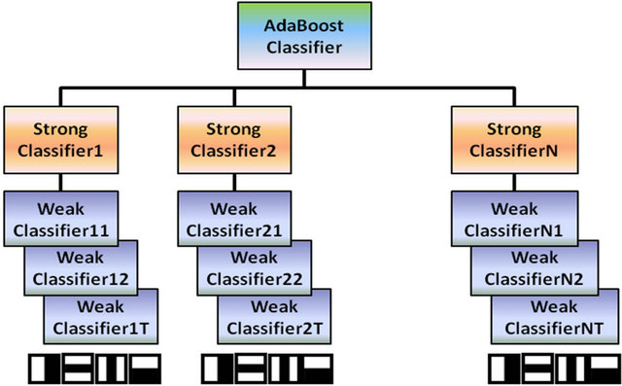
Adaboost:
Adaboost stands for “Adaptive” boost. Here we construct a strong classifier as linear combination of weak classifier as there are so many features which are absolutely invalid in finding the facial features.

Slide 20
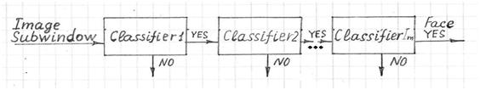
Cascade classifiers:
Cascading classifiers are trained with several hundred "positive" sample views of a particular object and arbitrary "negative" images of the same size. After the classifier is trained it can be applied to a region of an image and detect the object in question.
Positive images defines images with faces.
Negative images defines images without faces.

Slide 21
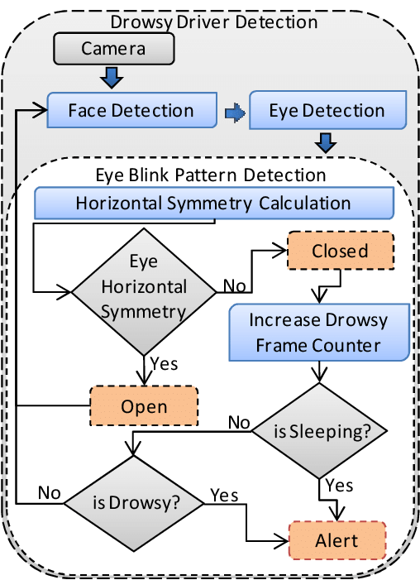
INPUT IMAGES AND OUTPUT

Slide 22
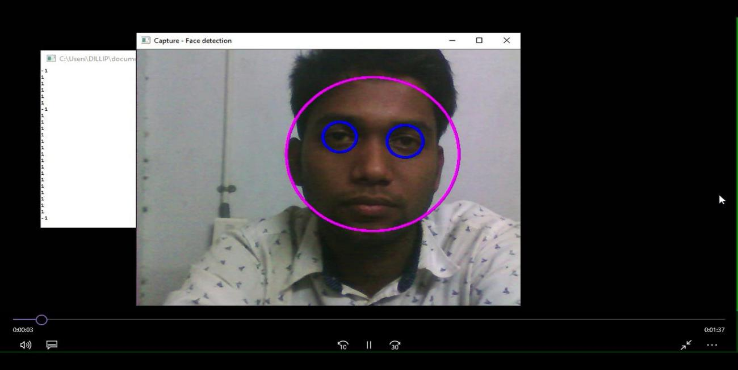
Input:
Output:
Eye in open state with head position= straight. Circle around the eye.

Slide 23
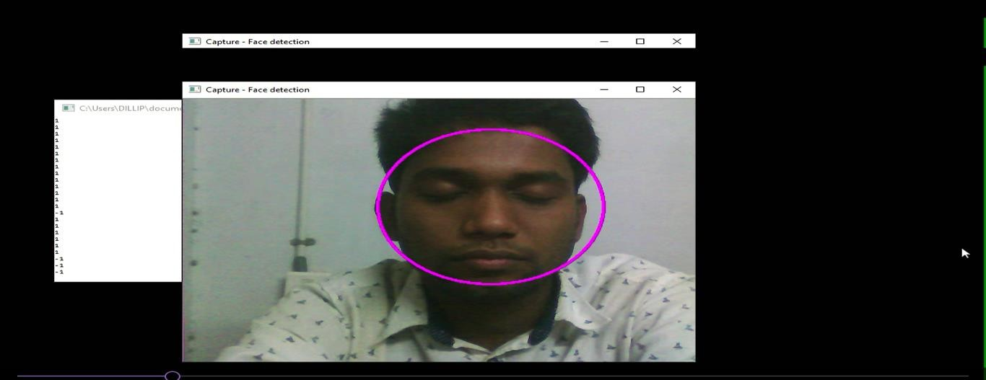
Input:
Output:
Eye in closed state with head position= straight. No circles around eyes.
so, it generates the alarm.

Slide 24
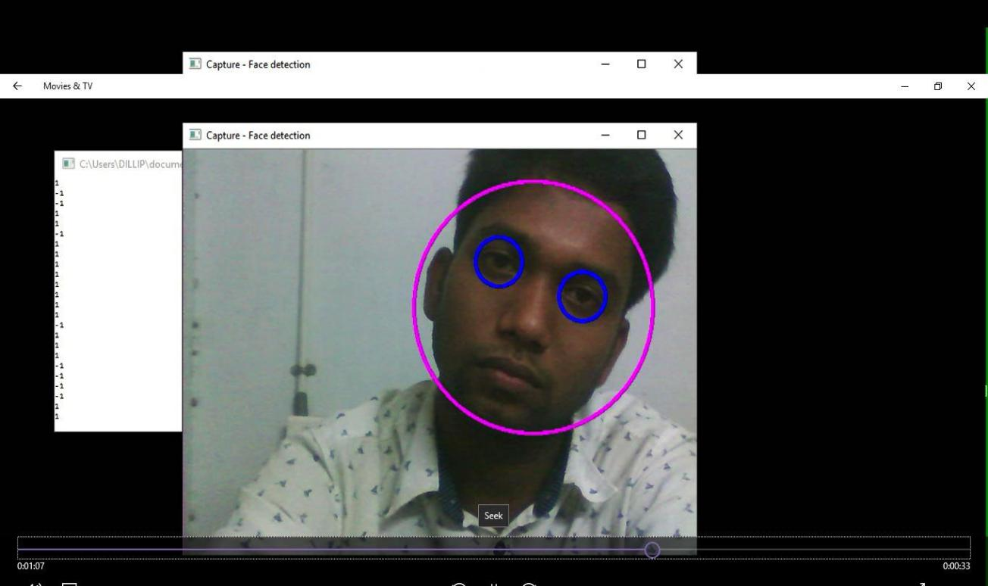
Input:
Output:
`Eye in open state with head position= Tilted (left).

Slide 25
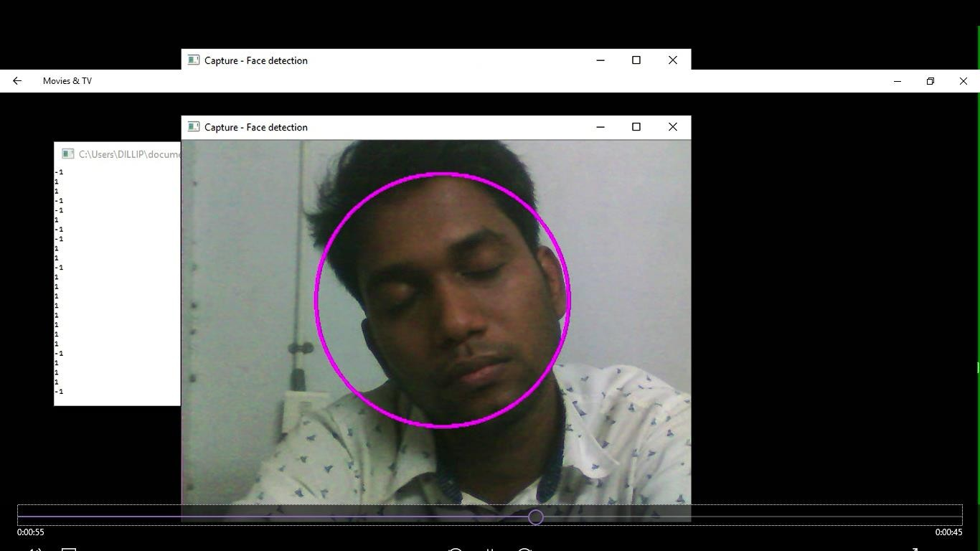
Input:
Output:
Eye in closed state with head position= Tilted (Right).

Slide 26
CONCLUSION
Captured video using Raspberry-pi was divided into frames and each frames were analyzed. Successful detection of face followed by detection of eye. If closure of eye for successive frames were detected then it is classified as drowsy condition else it is regarded as normal blink.,capturing is continued in a loop.

Slide 27
FUTUTRE ENHANCEMENT
Our model is designed for detection of drowsy state of eye and give and alert signal or warning may be in the form of audio or any other means. But the response of driver after being warned may not be sufficient enough to stop causing the accident.
Hence to avoid this we can design and fit a motor driven system and synchronize it with the warning signal so that the vehicle will slow down after getting the warning signal automatically.

Slide 28
THANK YOU

Slide 29
QUERIES....?

